Slide 1




A Data-Driven Stock Portfolio Analysis
(Value & Growth)

Slide 2

About me
Shenbaga Arun K - Bachelor of Science in Animation.
I have developed a passion for data analysis and quantitative
charting through my personal investment analysis using Excel.
Been always curious and interested to transform complex,
unstructured data into clear, customized insights and easily readable narratives.
As code drives modern digital environments. And world is shifting towards AGI, I am seeking to strategically align my career with AGI and LLM technologies, focused on mastering Machine Learning and tools like LangChain to build the advanced analytical systems.
4 years as a Texturing Artist at Xentrix Studios, providing a strong foundation in visual precision and iterative problem-solving
Linkedin profile LinkedIn_Profile
Github - Github_Profile

Slide 3

Business Problem Statement
The Indian market's vastness of ≈5600 listed stocks and numerous
influencing factors create significant complexity, making sound
investment decisions inaccessible to the average retail investor.
While fundamental and financial data is publicly available, the extensive
time and effort required for comprehensive analysis pattern recognition
and finacial performance is prohibitive for working professionals.
Deriving a ranking system through set formula based on funadamentals and financial performance to find desirable and strong stocks for each individual investment plan.
Goal - To provide data-driven key insights for portfolio analysis by identifying valuable stocks that exhibit strong fundamentals and robust financial growth.
Analysis is focused exclusively on Large and Mid Cap stocks priced below ₹1000 to minimize volatility and maximize stability.

Slide 4
Objective of the Project
Find Value and Quality: Use a set of conditions to pinpoint stocks that are both undervalued (cheap relative to their peers) and financially profitable (high ROE).
Ensure Safety and Income: Mitigate risk by filtering for companies with low debt and identify those that provide reliable passive dividend income.
Benchmark Performance and Momentum: Rank companies based on their ability to consistently grow sales and profit, revealing the fastest-moving, high-momentum performers.
Visual Analytical Ranking : Develop a universal ranking system so investors can objectively compare a stock's overall strength, regardless of its industry or sector.
Deliver Actionable Insights: Turn complicated financial data into clear, visual charts that provide simple, ready-to-use advice for long-term investment decisions.

Slide 5
Data Collection - Web Scrapping
Website - https://groww.in/stocks/filter
As per my Problem Statemnet, I have filtered the stocks in Mid and Large cap with the price range of 0 - 1000. Used Groww’s stock screener page.
Process followed in Web Scrapping
Used Python libraries requests and BeautifulSoup for scrapping the data.
Automated collection by iterating across multiple listing pages. Scraped individual stock URL paths from the filtered listing pages to enable sequential deep-dive collection.
Stocks not checking through set conditions and requried data are excluded from the dataset.
Executed secondary requests to extract key financial and fundamental metrics like P/E, ROE, Debt, Growth, etc. for each stock.
Calculated Net Revenue Growth, Net Profit Growth and EBITA margin from the extracted data using a defined formula.

Slide 6
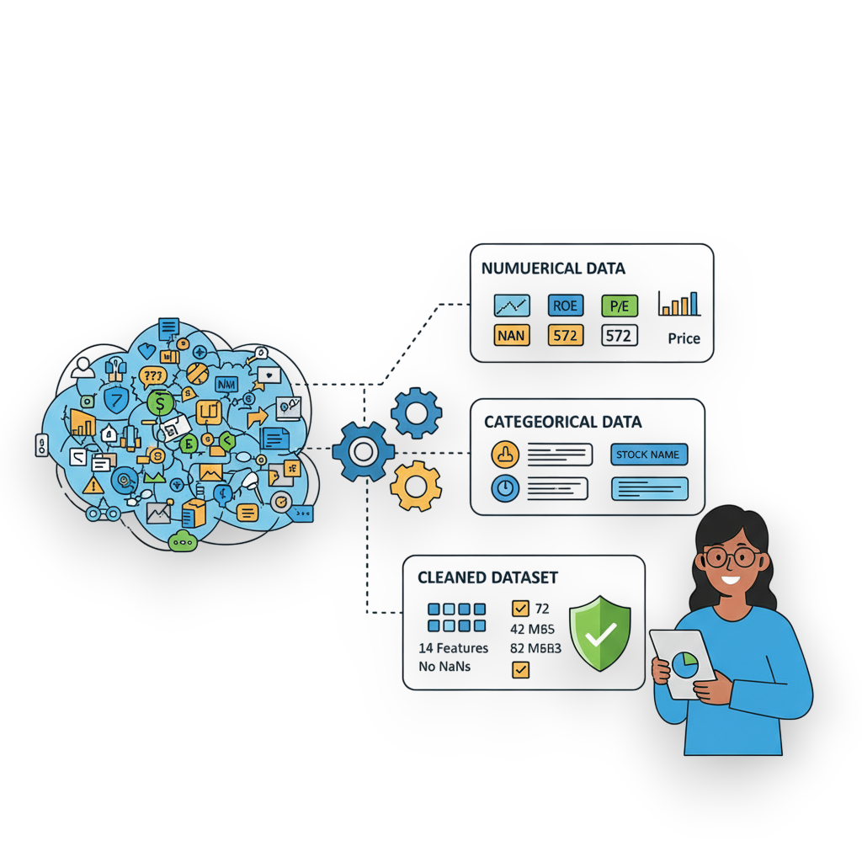
Summary of the Data
Shape for the Data Frame - 449 Stocks, 14 columns/Features
Columns/Features
Categorical | Numerical
Stock_Name,Market Cap | Current_Price (₹), Return_On_Equity (ROE) %, Price_to_Earnings_ratio (P/E), Industry P/E, Earnings_per_share (EPS), Price_to_Book_ratio (P/B), Dividend Yield %, Debt_to_Equity, Revenue_Growth %, Profit_Growth %, Net_Profit_Margin %, EBITDA Margin %.

Slide 7
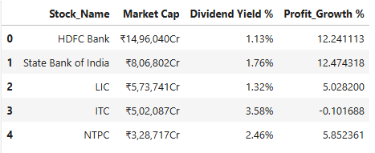
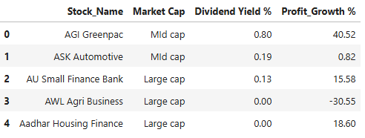
Exploratory Data Analysis:
Data Cleaning Steps
₹, %, ”,”symbols and other string values like “cr” are removed and data is returned to the standard int and float formats.
Numerical values are rounded to 2 decimal points for easier understanding.
Arranged the Data in the ascending order of the Stock_Name data.
Before
After

Slide 8
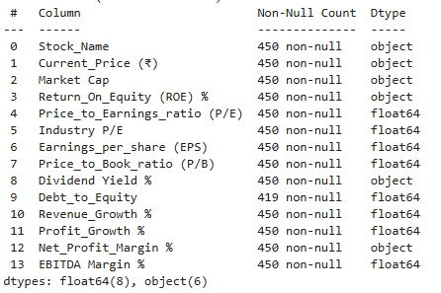
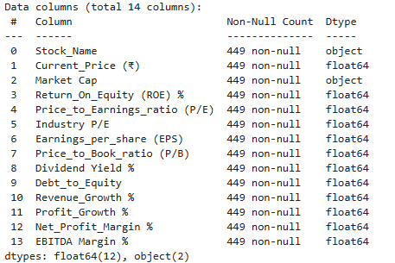
Data Manipulation Steps
Market Cap - values are cleaned and converted to categorical type and segregated into values <20,000 as Large Cap and >20,000 as Mid Cap.
31 Missing values found in Debt-to-Equity, has been filled(.fillna) with the Median value as data had outliers.
Data types are altered to the most accessable and accurate format for all the numeric data sets.
Found one duplicated row, removed with drop_duplicates function.
Before
After

Slide 9
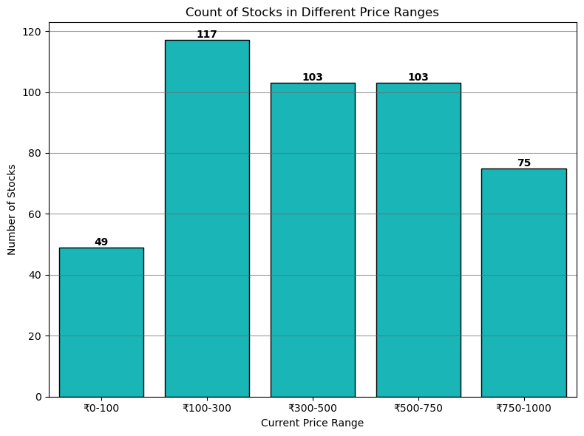
Univariate Analysis Steps
Current Price
Key Insights
From the chart, Majority stocks concentrated on 100-300 price range.
The highest & Lowest priced bin contain the fewest stocks.
The frequency generally decreases as the price increases, confirming the highly skewed nature of the price distribution, even in the mid and large-cap segments.
One can invest in large volume in a low priced stocks ranging 100-300, as with number of stocks increase the probability of quality stocks increases.

Slide 10
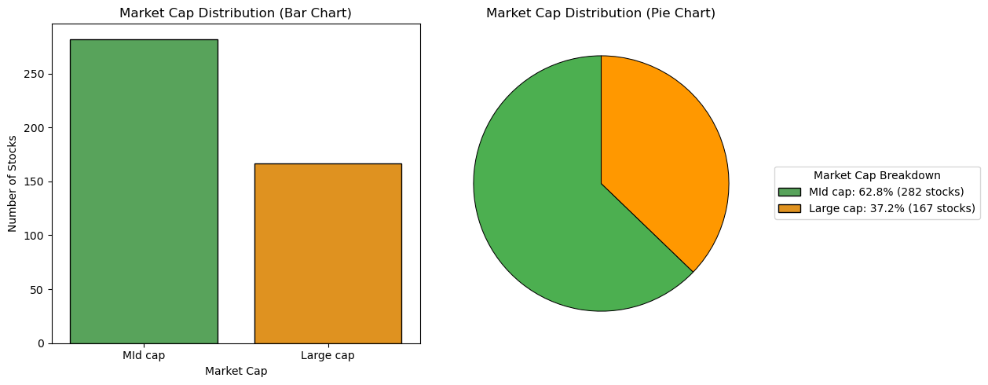
Market Cap Distribution
Key Insights
From the chart, Sample contains 62.8 % Mid cap stocks and the rest 37.2 % Large Cap.
In the price range of below ₹1000, majority stocks are concentrated on Mid cap.
Conclusion : There are fewer large cap compaines holding majority in Market value compared to Mid cap.

Slide 11
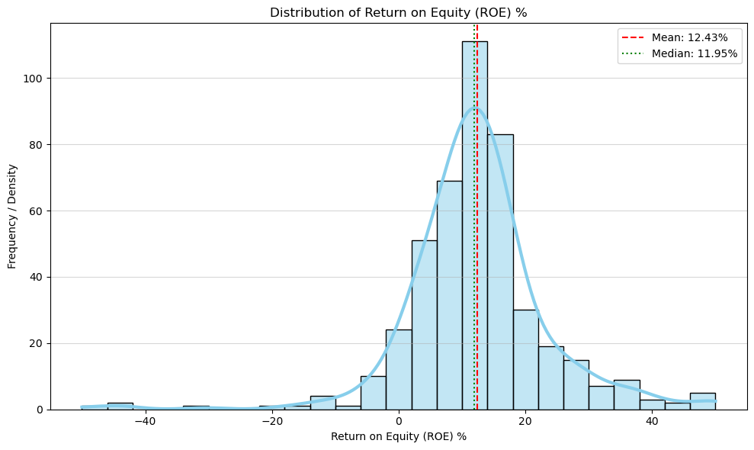
Return_On_Equity (ROE) %
Key Insights
The distribution is highly left-skewed, with a long tail extending into the low negative ROE values. The bulk of the data is concentrated on the lower end.
The highest concentration of stocks lies in the 10% to 15% ROE range. Indicating average ROE of the sample stocks
A noticeable number of companies are clustered around 0% and into the negative territory, indicating they are generating losses relative to shareholder equity.

Slide 12
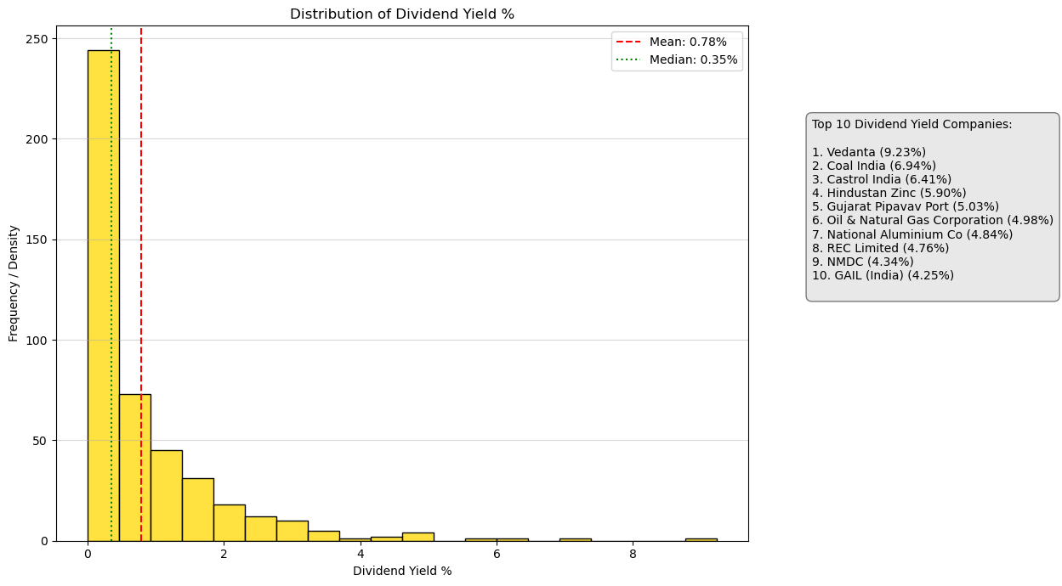
Dividend Yield %
Key Insights
The dividend yield distribution is highly skewed, with most companies paying a very low or no dividend.
Very few companies are paying any dividend as 0 % is the kurtosis(peak) of the data.
From the top 10 list, Mining/Mineral and Petroleum compaines are highest dividend paying stocks.

Slide 13
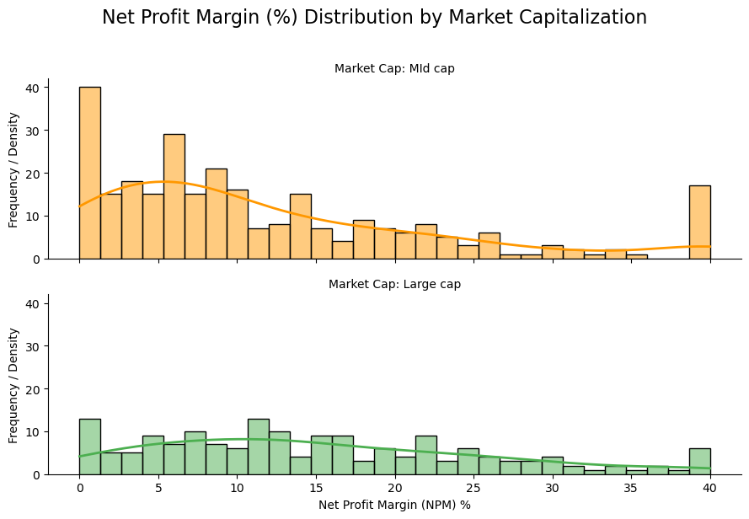
Net Profit Margin (%) - Market Capitalization
Key Insights
Mid Cap the distribution is wider and flatter, indicating more variability in margins.
This reflects the greater inherent risk and less established market position often found in mid-cap companies.
Large Cap the distribution is tighter and more heavily concentrated in the positive range (10% to 25%).
This suggest greater stability and generally higher margins, likely due to their scale and market dominance.

Slide 14
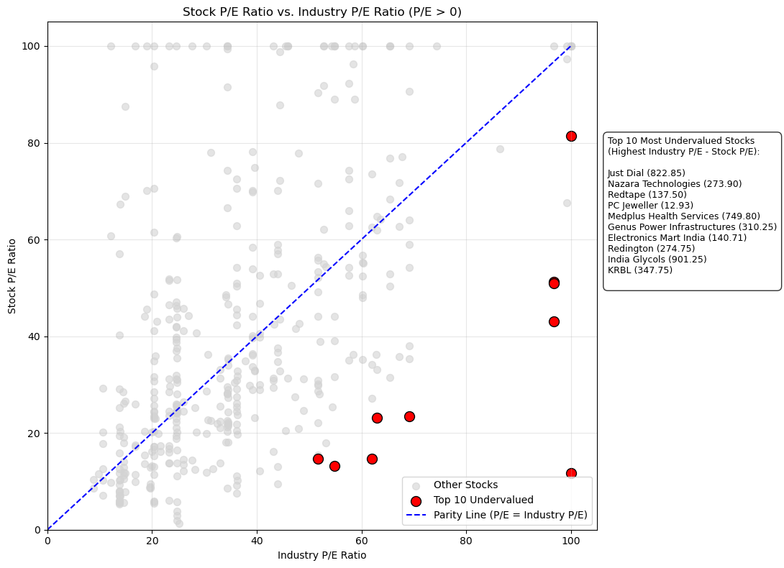
Bivariate Analysis Steps
Is my stock is undervalued or overvalued ? - P/E vs Industry P/E
Key Insights
Metric for Undervaluation is calculation of the difference Industry P/E - Stock P/E.
A high positive difference indicates the stock is relatively undervalued compared to its industry.
From the plot, Top 10 undervalued companies with relatively higher PE are mapped out.
Nazara Technogies,Redington are some of the better option among the mapped out stocks.

Slide 15
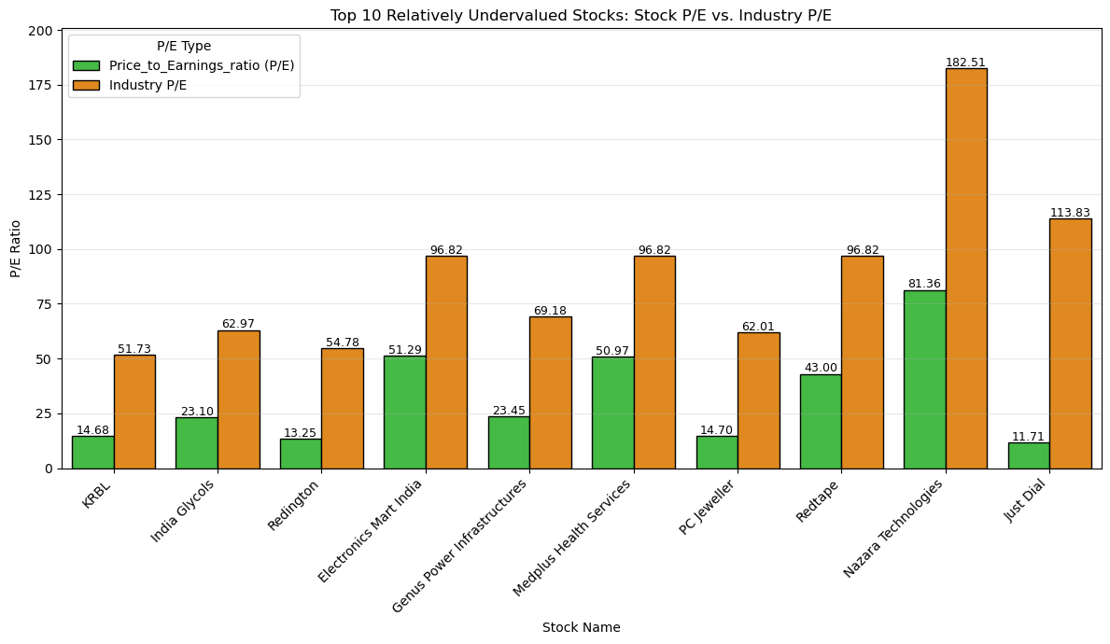
Top 10 Relatively Undervalued Stocks: Stock P/E vs. Industry P/E
Key Insights
In this chart, the Orange Bar of Industry P/E is significantly taller than the Green Bar of Stock P/E, Indicating the stocks are undervalued compared to their peers
This visual confirms that these companies are trading at a P/E ratio lower than the average of their respective industries. As mentioned in the previous slide

Slide 16
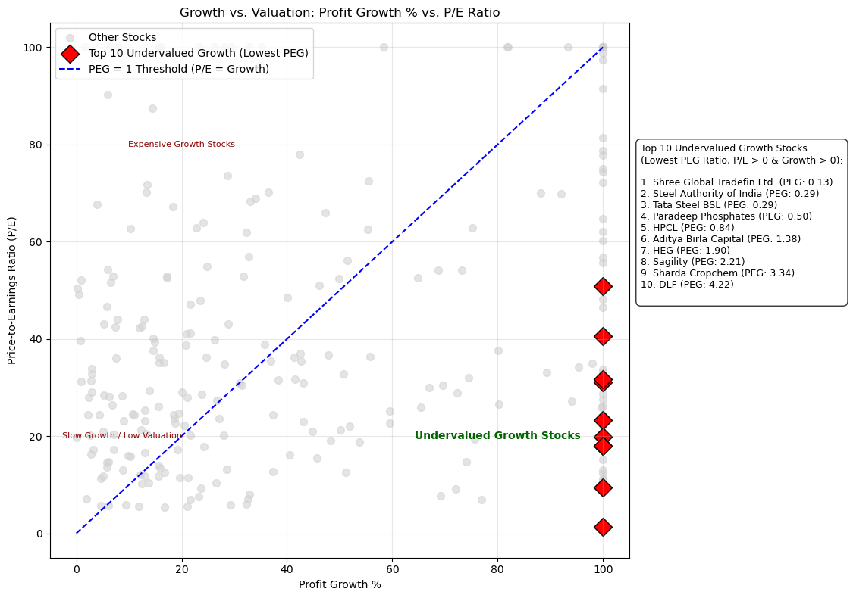
Growth & Valuation: PEG - Profit Growth % vs. P/E
Key Insights
PEG Ratio = P/E Ratio
Profit Growth %
A stock is generally considered undervalued growth if its PEG Ratio is less than 1.
We filter for stocks that are both profitable (P/E > 0)and growing (Profit Growth > 0).
Goal is to get lowest PEG ratio.Profit growth max & P/E min.
We can get undervalued stocks with profit growth pontential.

Slide 17
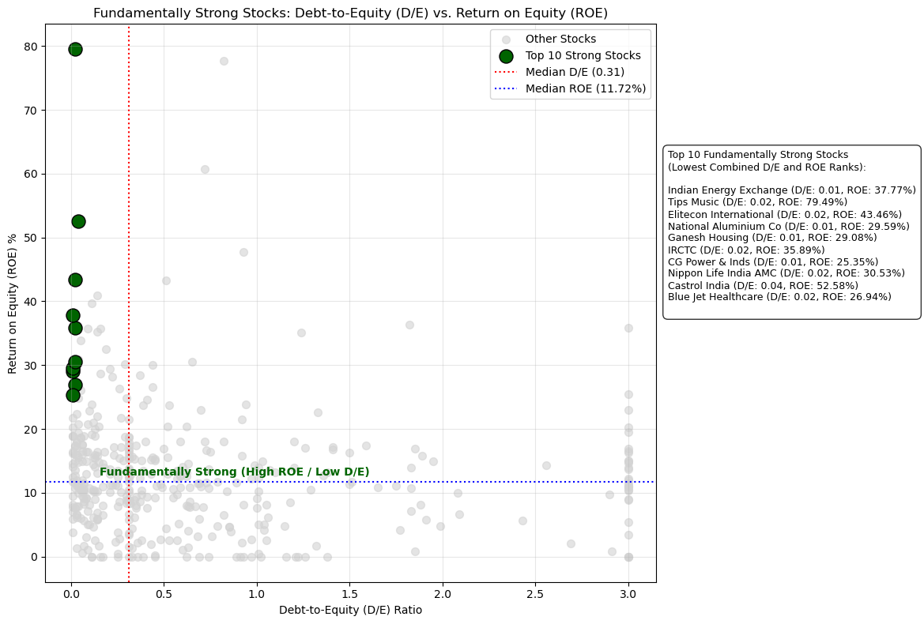
Is My Stock Fundamentally Strong Stock - (ROE vs. D/E)
Key Insights
Strength Score = Rank(D/E) + Rank(ROE)
Goal is to get Low D/E evading the debt risk and high ROE achieving more returns.
As this analysis gives us the stocks which functionaing with relatively less debt and providing more return on the investment. Making it a ideal analysis for strength.
Majorly we can government sectors stocks and saom of the well established larger companies in the top 10.

Slide 18
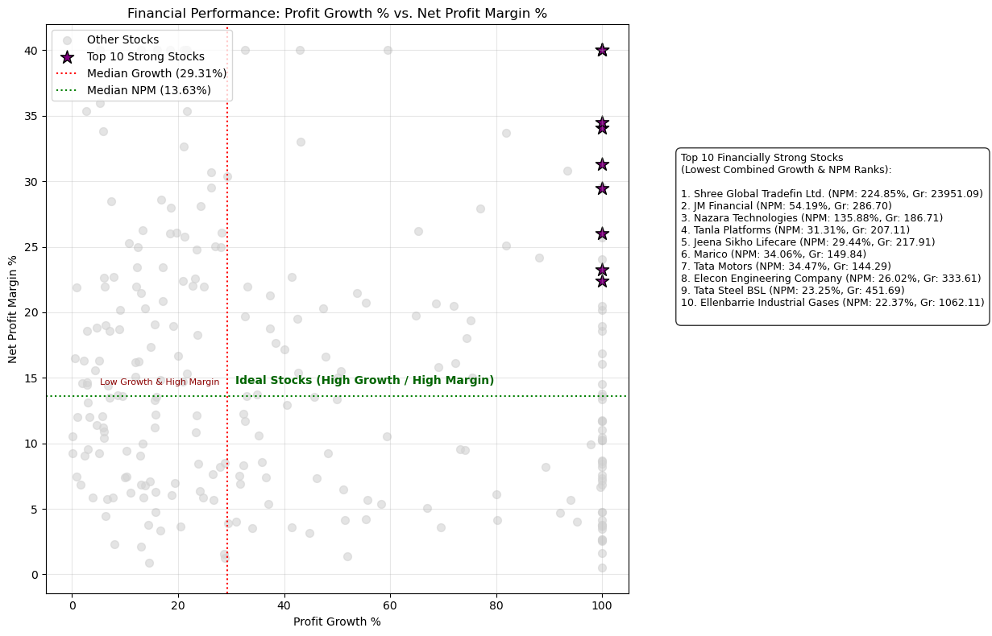
Financially Well Performing Stocks (Growth vs. Profitability)
Key Insights
Performance =Rank(Profit Growth)+Rank(NPM)
The lowest Performance Score indicates best balance of high growth and high profitability.
Stocks with higher profit growth and high Net Profit margin indicates the overall financial growth of the company.
Nazara Technogies, Tata Motors and Tata Steel are some of the better options with good financial performance.

Slide 19
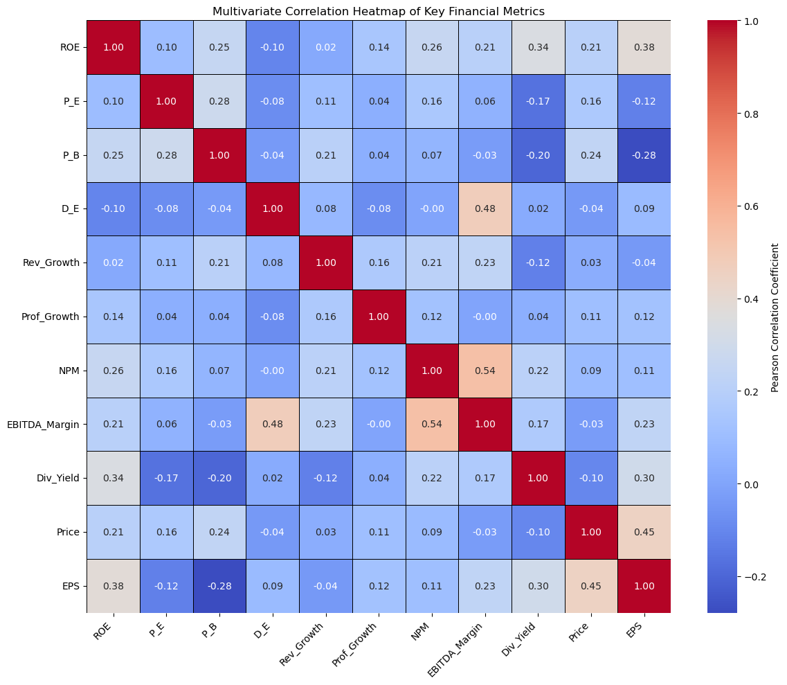
Multivariate Analysis Steps
Key Insights
Corelation Heat map
Return on Equity (ROE) and Net Profit Margin (NPM): Comapnies with high profit trend to generate more return.
Earnings Per Share (EPS) and Current Price (Price): 0.45. This is fundamental: higher EPS often leads to a higher stock price.
Debt-to-Equity (D_E) and ROE : (-0.10) . The relationships are generally weak, indicating that debt level is not a primary driver of stock performance or valuation
Rev_Growth and Prof_Growth: A moderate positive correlation (0.16). This is expected but not extremely high, suggesting that many companies are growing revenue without proportional profit growth.

Slide 20
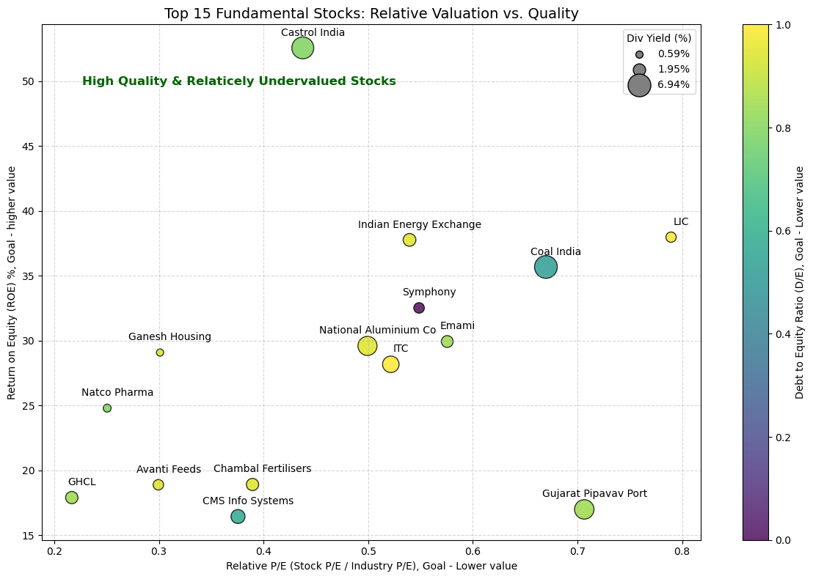
Top 15 Fundamental Strong Stock - Relative P/E vs ROE vs D/E vs Div Yield
Key Insights
Conditions used:
1. PE_Relative <= 0.80 (Stock P/E is at least 20% lower than Industry P/E)
2. ROE >= 15 (ROE is 15% or higher)
3. D_E <= 0.5 (Debt to Equity - 0.5 or lower)
4. Div_Yield > 0 (Must pay a dividend)
The stocks that passed the filter were ranked based on the combined performance across these four metrics.
From the plot, Majorly got FMCG, Pharma, PSU and mineral / mining companies.
Natco Pharma, Castrol India, Coal India and GHCl are some of the fundamentally strong stocks.

Slide 21
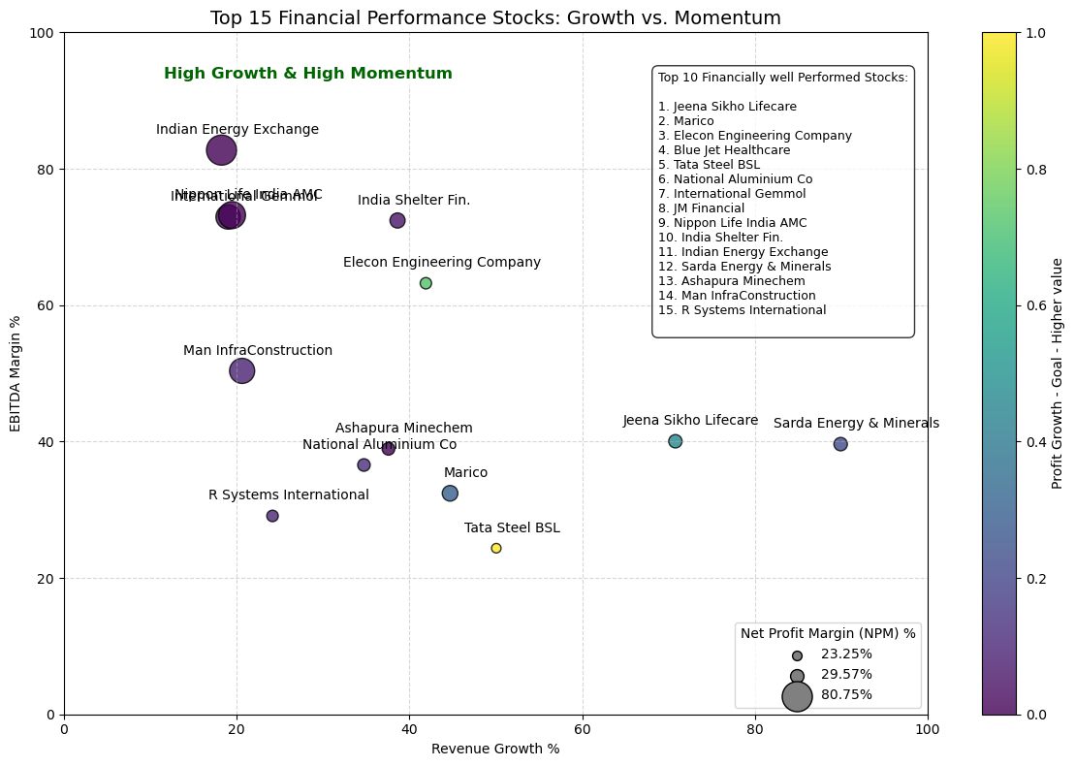
Top 15 Financial Performance Stock - Rev_Growth vs Prof_Growth vs NPM vs EBITDA_Margin
Key Insights
The stocks were ranked based on a combination of Revenue Growth, Profit Growth, Net Profit Margin (NPM) and EBITDA Margin with goal of higher value.
Stocks with high revenue and EBITA margin does fail in generating a high profit growth indicating a higher growth potential in a long term with the risk of debt.
Tata Steel BSL, National Alumnium co - mineral / mining companies.
Indian Energy Exchange, Sarda Energy & Minerals - Engery sector.
JM Financial and Nippon Life insurance AMC - Finance sectors.

Slide 22
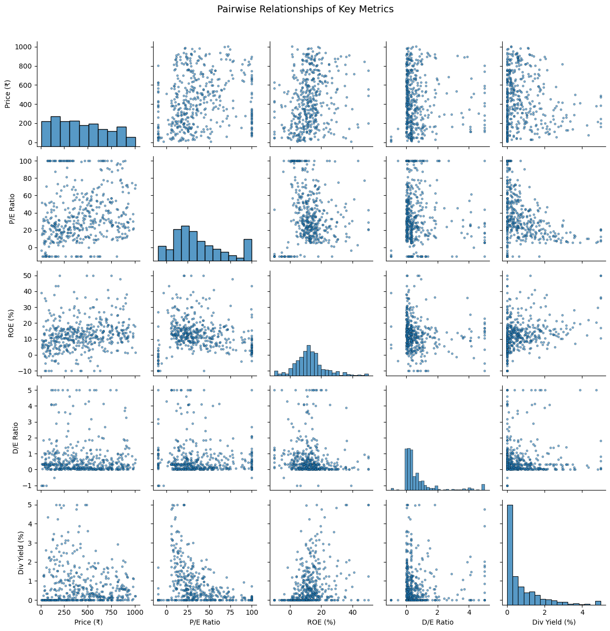
Pairwise plot for Stock Fundamentals
Key Insights
Price (₹) vs. Fundamentals - higher prices shows a slight tendency to correlate with better fundamentals indicating the market rewards quality over time.
ROE (%) vs. D/E Ratio - Most stocks that can achieve high ROE do so with low D/E. The scatter plot confirms that high profitability is achieved across the range of conservative debt levels.
Price (₹) and Div Yield (%): Both will be highly concentrated at the lower end of their respective ranges, with long tails indicating the presence of a few very expensive or high-dividend-paying stocks.
P/E Ratio vs. ROE (%) - High-quality companies (high ROE) tend to command a higher P/E ratio.
Some of the values are clipped to get better understanding.

Slide 23

Key Business Question
Which stocks are cheap right now, but still high-quality?
Are these companies safe? Do they have too much debt?
Which stocks under ₹1000 offer the best potential for stable income through a competitive Dividend Yield?
How can I quickly identify companies that are financially sound with low debt levels (low D/E ratio) for safer long-term holding?
Which Large and Mid Cap stocks are currently undervalued (low P/E) yet maintain a strong fundamental quality (high ROE)?
which stocks show the strongest recent momentum, demonstrating high Revenue and Profit Growth simultaneously?
Across different industries, which companies rank highest overall when considering a combination of profitability, safety, and growth metrics?

Slide 24
Conclusion Key Findings
By focusing exclusively on Large and Mid Cap stocks under ₹1000, the analysis provides a stable, manageable data, eliminating the risk and overhyped valuation of small-cap shares.
High-quality stocks (characterized by strong ROE) consistently command a higher valuation (P/E), confirming that the market rewards fundamental excellence.
The most profitable companies achieve their high returns while generally maintaining conservative debt levels (low D/E), reinforcing the principle that financial stability underpins sustained profitability.
The system identifies a cohort of all-rounder stocks that balance undervaluation, quality, and growth—ideal for stable, long-term wealth creation.
Many companies are growing revenue without proportional profit growth. Which misleads the decision makers.
Very few stocks from the smaple excel in major conditions, to name a few: National Alumnium co,Castrol India,Coal India,Natco Pharma and Nazara Technologies

Slide 25


Slide 26
Experience/Challenges
Challenges
Scrapping the data from each stock by iterating the stock_link_name list and using nested request achieve it.
To extract the fundamentals data, Stored them in one combined list and by using list indexing and for extracted data for each fundamentals.
Scrapping the financial statment data without the use of selinium.
As some stocks did not conatain financial statement for past 4 quaters, needed to find each them and exclude them from my list of sample.
Experience
Learnt to use multiple request within the for loops.
Access multiple sites inside a website using request and the common site link and extracted data.
Breakdown a large data and extract the reqiured data without overloading the system with complex loops.
Figured where the problem is arising and solved it using simple yet effective methods.
Automated process to cut back on time.
Tried various plots to get my desiered output.

Slide 27

THANK YOU

